Slide 1

Beyond the Numbers: The Hidden Story of Drug-Related Deaths
By- W.A.C Fernando(26545)
A.P.M Premasiri (26033)
R.T Dulmina (27999)
H.K.I Dhananjaya (27595)

Slide 2

Dataset: Accidental_Drug_Related_Deaths_2012-2023.xlsx
Focus: Accidental deaths caused by drug overdoses
Region: Primarily from the U.S. (Connecticut)
Contains demographic and drug involvement data
Brief Overview of the Dataset
Domain: Public Health / Epidemiology
Sri Lankan Context : -Rising concerns around substance abuse, especially among youth and urban populations, mirror trends seen in developed countries. -Understanding global overdose patterns can guide early intervention in Sri Lanka.

Slide 3

Problem Statement
Issue:
Accidental drug overdoses are a rising global health threat.
Why It Matters (Sri Lanka):
Substance abuse is increasing locally, but data and awareness are limited.
Early insights from other countries can help prevent a similar crisis in Sri Lanka.

Slide 4

Objective of the Analysis
Goal:
Use international data to uncover trends and apply insights to the Sri Lankan context
Research Questions:
Is age a significant factor when it comes to drug uses?
Is drug usage most high among males or females?
Around what age are the majority of the victims from?

Slide 5

Dataset Description
Source: Connecticut Office of the Chief Medical Examiner (public open data)
Time Frame: 2012–2023
Observations: ~10,000 deaths
Key Features:
Age, gender, race
Date and location of death
Drugs present at time of death etc.

Slide 6
Formatting Data:
Handling Missing Values
Data Cleaning Process
Imputing Data
Removing Unnecessary Columns
Grouping Rare Categories
Handling Race Column
Cleaning Injury Place Data
Final Refinements

Slide 7
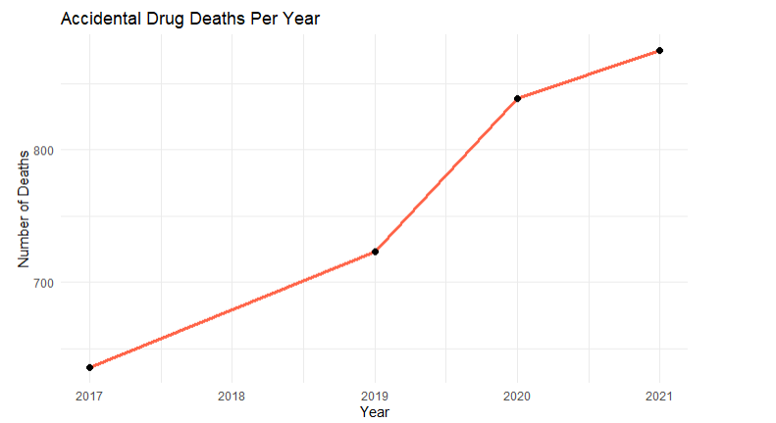
Deaths Per Year
Accidental drug-related deaths have risen sharply from 2017 to 2021, reflecting a global trend of increasing drug misuse.
2017: Lowest recorded deaths (~650).
2019: Steady increase (~730+ deaths).
2020: Significant spike (~860+ deaths), likely influenced by the pandemic.
2021: Nearing 900 deaths, continuing the upward trend.
Though this dataset is from overseas, Sri Lanka may face similar risks. Proactive public health measures are crucial to prevent future crises.

Slide 8
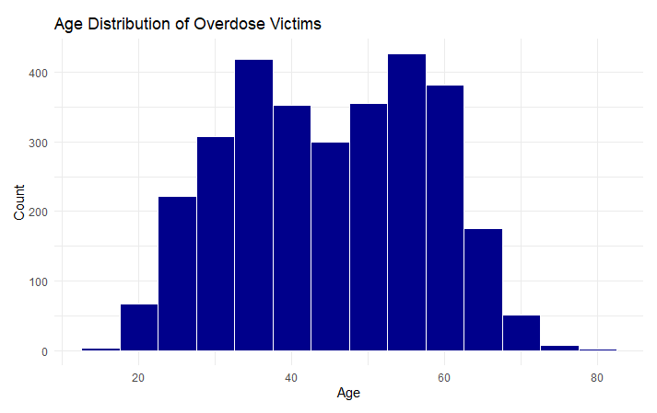
Age Distribution Of Victims
Overdose deaths peak in middle-aged adults (late thirties–60 years) with 300–400 deaths, likely due to chronic pain and substance dependence.
Lower rates in younger (20s) and older (70–80s) groups, possibly due to different substance use patterns.
Public health priority: Targeted harm reduction, mental health support, and prescription drug monitoring.

Slide 9
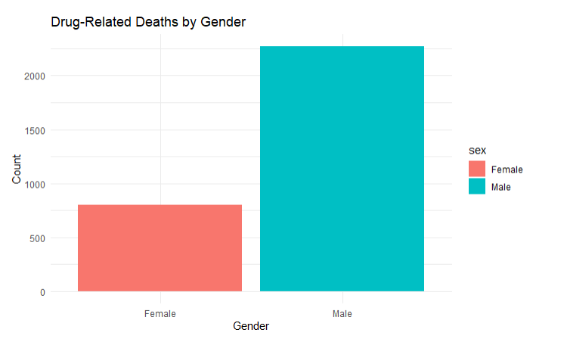
Deaths By Gender
Males experience significantly higher drug-related deaths than females, indicating differences in risk factors and substance use patterns.
Public health concern: The stark contrast highlights an urgent need for targeted interventions.
Key focus areas: Address male-specific risks through prevention programs, healthcare access improvements, and substance abuse research.

Slide 10
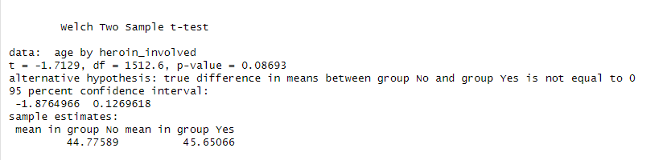
Age and Heroin-Related Overdose Deaths
Average age of overdose victims: No heroin – 44.78 years, With heroin – 45.65 years (difference ~0.87 years).
P-value (0.087) exceeds the 0.05 threshold, indicating no statistically significant difference in age between the two groups.
Confidence interval (-1.88, 0.13) includes zero, suggesting age differences may be due to chance.
Key takeaway: Heroin involvement does not distinguish overdose victims by age intervention policies should target all adult groups rather than focusing on specific age ranges.

Slide 11
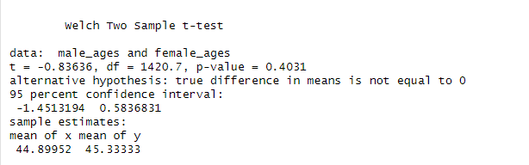
Age Differences in Overdose Victims by Gender
Mean age: Males (44.90 years) vs. Females (45.33 years) → Small difference (~0.43 years).
P-value (0.403) exceeds the 0.05 threshold → No statistically significant difference in age between male and female victims.
Confidence interval (-1.45, 0.58) includes zero → Any observed difference is likely due to chance.
Key takeaway: Gender does not meaningfully impact age at overdose—prevention efforts should be inclusive across all adult populations rather than focusing on gender-based age disparities.

Slide 12

Limitations & Future Work
Limitations:
Data is from a single U.S. state — not directly representative of Sri Lanka.
Future Work:
Try to analyze Sri Lankan health, crime, or hospital data
Collaborate with local authorities to build centralized overdose datasets.

Slide 13

Conclusion
Summary:
Drug overdose deaths are rising, driven by synthetic opioids.
Implication for Sri Lanka:
Learning from international data can help Sri Lanka prepare proactive interventions
Recommendations:
Analyze this scenario in Sri Lanka.
Launch awareness campaigns targeting at-risk populations.
Enforce better monitoring of prescription and illegal drug flows.

Slide 14
Aditional information
Used R-studio to do the coding
Used packages such as:
tidyverse
lubridate
ggplot2
janitor
ggthemes
purrr
readr
Dplyr
Dataset: Accidental_Drug_Related_Deaths_2012-2023.xlsx

Slide 15
Thank you!

